Slide 1
Learning Objectives
Know what Python is and some of the applications it is used for
Run a simple Python program in Interactive mode using the input and print functions
Write, save and run a program in Script mode
Understand what a syntax error is and how to interpret an error message
Know the rules for variable names and use variables in a program
Understand the use and value of comments in a program

Slide 2
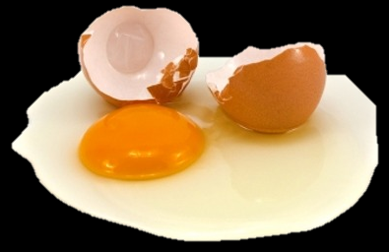
Frying an Egg
Sequencing Instructions:
What is the correct order of these instructions?
Put pan on hob
Break egg
Get frying pan
Put oil in pan
Turn on hob
Hold egg over pan

Slide 3
Programming
Sequencing Instructions
Sequence Order Important
Accuracy Important

Slide 4
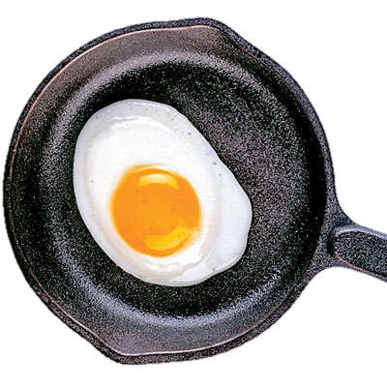
Frying an Egg
Get frying pan
Put pan on hob
Turn on hob
Put oil in pan
Hold egg over pan
Break egg

Slide 5
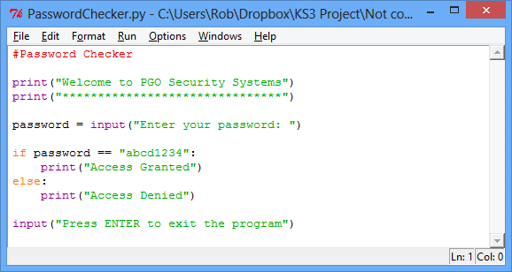
Example Code

Slide 6
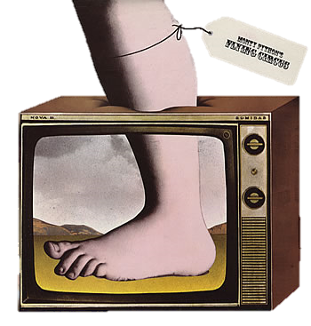
Python Language
Simple to Learn
Used by:
  Nokia
  NASA
  Paint Shop Pro
  Google’s Search Engine
  Civilisation 4 Computer Game
  CERN Large Hadron Collider Research

Slide 7
Python’s Development Environment
Called IDLE – Integrated Development Environment
Two Modes:
  Interactive Mode let you see your results as you type them
  Script Mode lets you save your program and run it again later

Slide 8
“Hello World!”
A programming tradition
A simple program to display text on the screen
In IDLE’s Interactive Mode type:
print ("Hello World!")
Press Enter
Try again with some different text.

Slide 9
Getting it Wrong
Syntax Errors
Experiment with errors
In IDLE type the following erroneous lines:
primt ("Hello World!")
Print ("Hello World!")
print (Hello World!)
print "Hello World!"

Slide 10
De-Bugging
Syntax Errors
Reading interpreter feedback
Traceback (most recent call last):
File "<pyshell#0>", line 1, in <module>
primt ("Hello World!")
NameError: name 'primt' is not defined

Slide 11

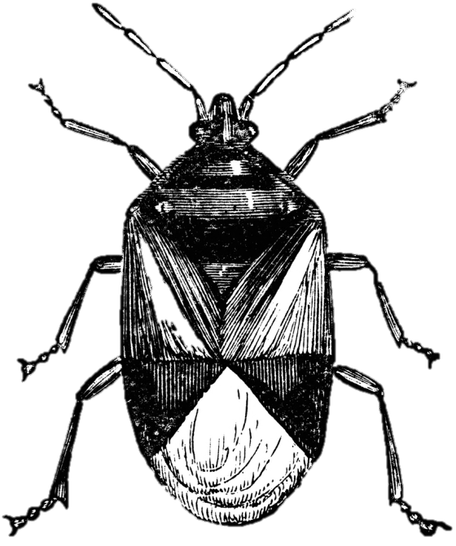
Computer Bugs
The name ‘Bug’ refers to an error in a program
Thought to come from a real bug that crawled into some cogs in an early machine and stopped it working

Slide 12
Using Script Mode
In IDLE, Open a New Window
Type:
print ("What is your name?")
firstname = input()
print ("Hello,",firstname)
Save the program as MyFirst.py
Press F5 to ‘Execute’ or Run the program

Slide 13
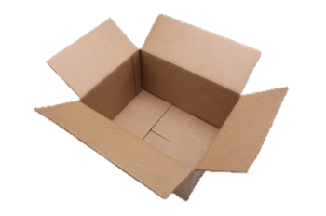
What is a variable?
A variable is a location in memory in which you can temporarily store text or numbers
It is used like an empty box or the Memory function on a calculator
You can choose a name for the box (the “variable name”) and change its contents in your program

Slide 14
Rules for Naming Variables
A variable name can contain only numbers, letters and underscores
A variable name cannot start with a number
You can’t use a Python “reserved word” as a variable name – for example class is a reserved word so class = input() will result in a syntax error.

Slide 15
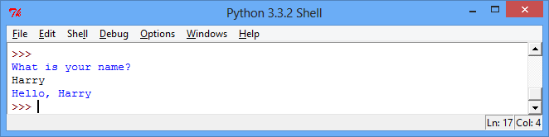
Using a Variable
print ("What is your name?")
firstname = input()
print ("Hello,",firstname)

Slide 16
Adding Comments
Comments are useful to help understand your code
They will not affect the way a program runs
Comments appear in red
Comments have a preceding # symbol
#firstname is a variable
print ("What is your name?")
firstname = input()
print ("Hello,",firstname)

Slide 17
Functions
Functions are special keywords that do a specific job
Functions appear in purple
print() and input() are examples of functions
print ("What is your name?")
firstname = input()
print ("Hello,",firstname)

